Slide 1
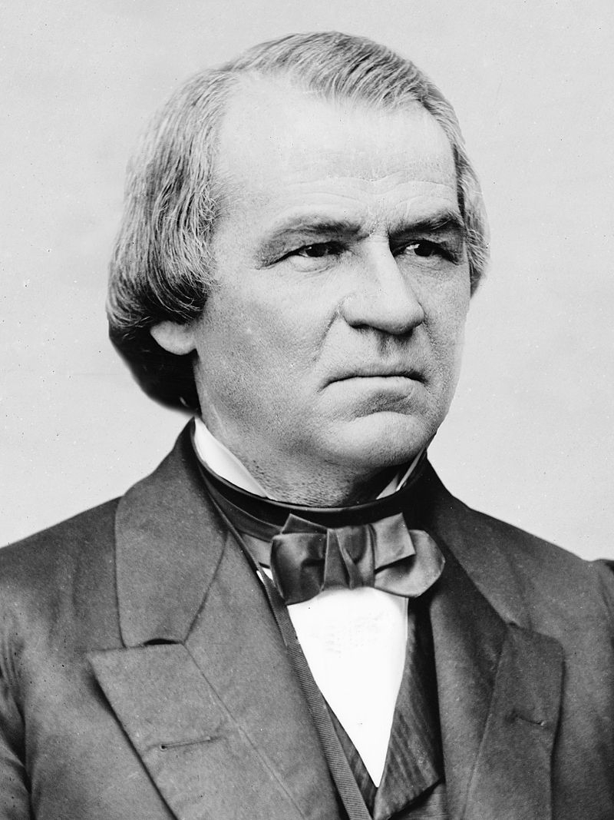
Andrew Johnson

Slide 2
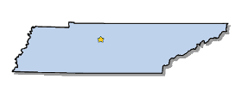
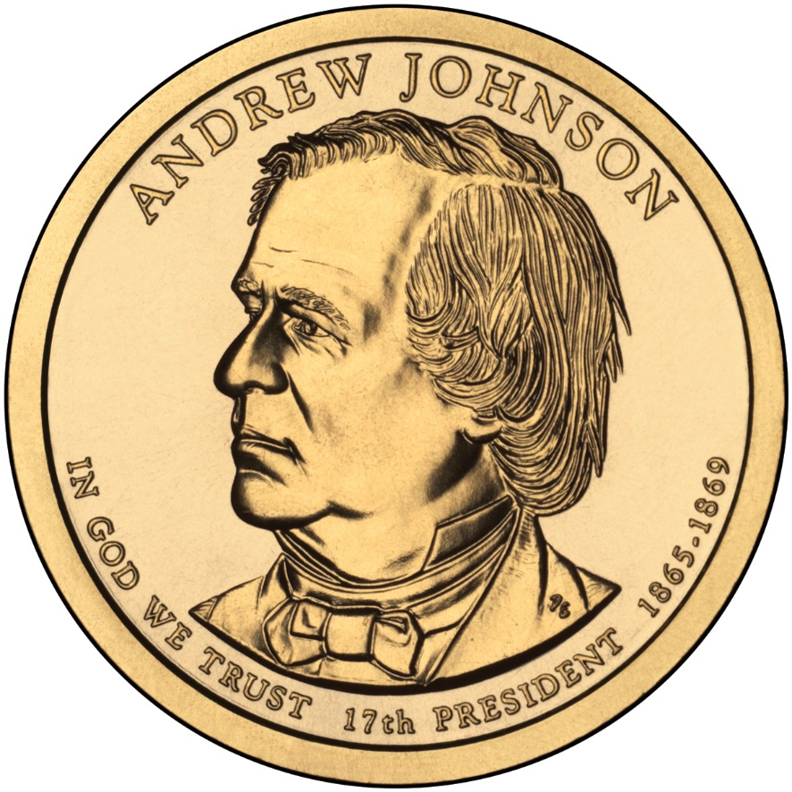
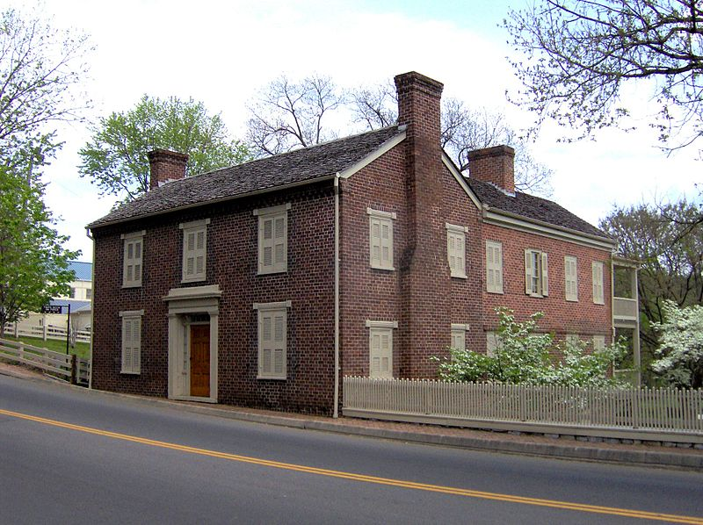
Elected in: Unelected
Political Party: Democrat
President from: 1865-1869
Home State: Tennessee

Slide 3
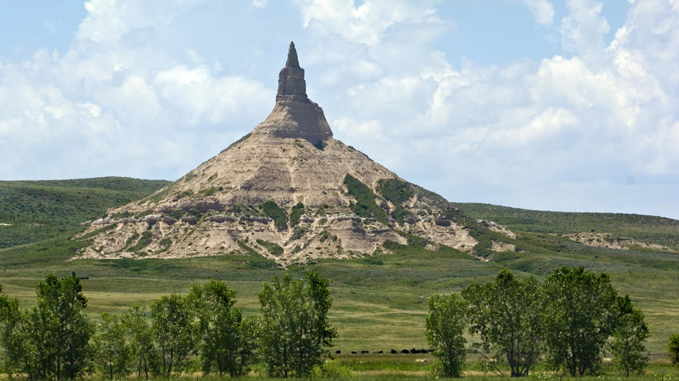
New States
37. Nebraska

Slide 4
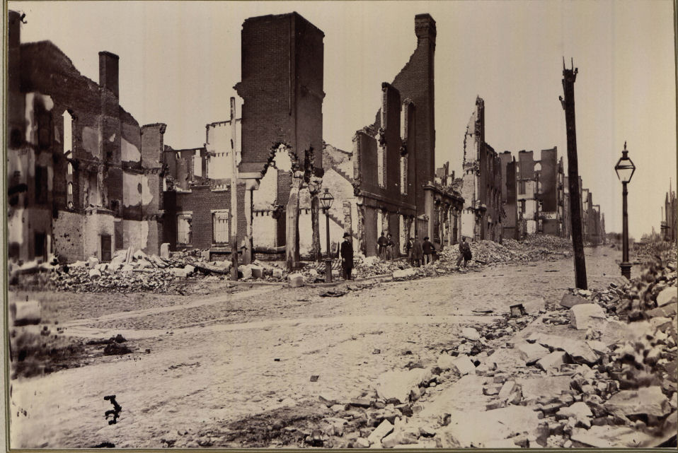
1) Southern Reconstruction: The attempt to rebuild and transform the Southern states after the Civil War, both physically and socially. Goals were to readmit the destroyed South into the Union, and protect the rights of former slaves.

Slide 5
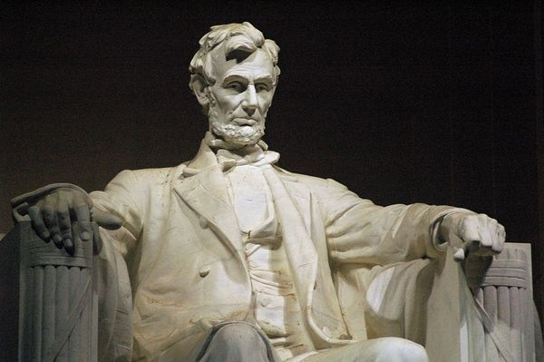
Lincoln’s View of Reconstruction:
- Based on forgiveness
Amnesty for Southern people (not leaders)
States could be readmitted when 10% of the population swore loyalty to US
White-owned property protected, though not their slaves
-Opposed by Radical Republicans in Congress, who passed the much tougher Wade-Davis Bill (Vetoed by Lincoln)

Slide 6
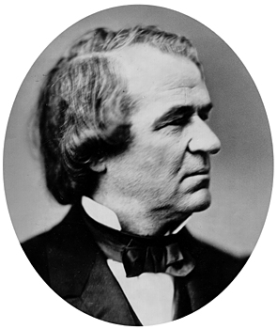
Johnson’s View of Reconstruction:
Southern states should decide for themselves how to best rebuild
Blacks were not capable of managing themselves and shouldn’t have the right to vote.
Amnesty for Southern people, and most leaders were pardoned. Some rejoined the US Govt.
States could be readmitted when they repealed secession and ratified the 13th Amendment (this was not strictly enforced)
White-owned property protected, though not their slaves

Slide 7
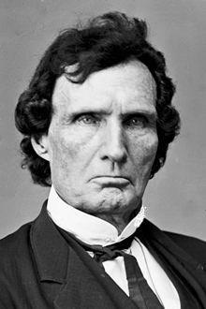
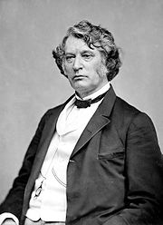
Radical Republicans’ View of Reconstruction:
Radical Republicans: Stressed punishment for Confederate leaders and equality for former slaves
Federal government and army must take lead in Reconstruction and occupation
Southern leaders must be punished and property confiscated
Former slaves must be provided food, education, land, medical care, and full citizenship including the right to vote.
Thaddeus Stevens
(Pennsylvania)
Charles Sumner
(Massachusetts)

Slide 8
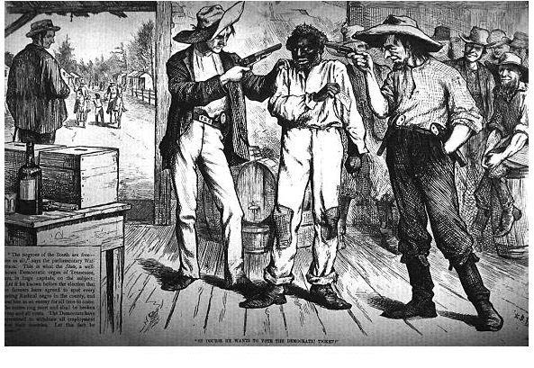
The Black Codes
Laws passed by (mostly) Southern states in 1865 and 1866 with the intent and the effect of restricting African Americans' freedom, and of compelling them to work in a labor economy based on low wages or debt.
- Restricted property ownership/lease/rent rights
- Made unemployment illegal
- Required annual work contracts
- Rented convicts to plantations
- Restricted weapons and alcohol
possession
- Children could be seized by the state
and sent to work
- Restricted access to towns and public
spaces, and nightly curfews

Slide 9
Civil Rights Act of 1866
Granted full citizenship to African Americans.
-Johnson vetoes the act in 1866, Congress overrides the veto
Freedman’s Bureau:
Federal agency set up to help former slaves after the Civil War
(Clothing, food, shelter, schools and colleges)
-Johnson vetoes a renewal of the bureau in 1865, Congress overrides the veto
Second Reconstruction Act
Southern states must hold elections to write new Constitutions to include former slaves
-Johnson vetoes, Congress overrides the veto
First Reconstruction Act:
South to be divided into 5 military districts, overseen by Army
-Johnson vetoes, Congress overrides the veto

Slide 10
13th Amendment - 1865
-Outlaws slavery in the United States
Neither slavery nor involuntary servitude, except as a punishment for crime whereof the party shall have been duly convicted, shall exist within the United States, or any place subject to their jurisdiction.

Slide 11
14th Amendment - 1865
-Former slaves are made full citizens, and thus entitled to equal protection under the law.
- Former slaves count equally, and states that deny this are denied full representation
-Former Confederate rebels can’t serve in Congress unless a 2/3 vote in Congress admits them
- US will not pay old Confederate debts
All persons born or naturalized in the United States, and subject to the jurisdiction thereof, are citizens of the United States and of the State wherein they reside. No State shall make or enforce any law which shall abridge the privileges or immunities of citizens of the United States; nor shall any State deprive any person of life, liberty, or property, without due process of law; nor deny to any person within its jurisdiction the equal protection of the laws…

Slide 12
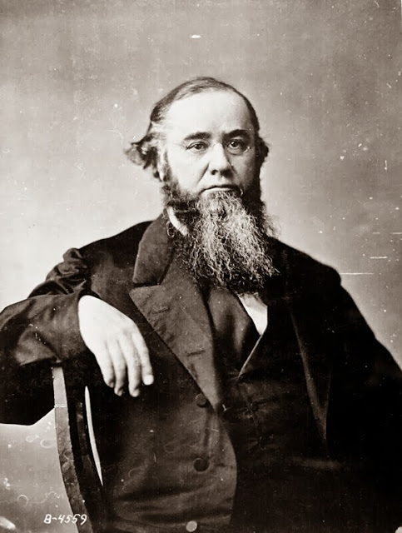
Tenure of Office Act
Law prohibits the President from removing any government office holder without Senate approval
-Meant to protect Secretary of War Edwin Stanton
-Vetoed by Johnson, overridden by the Congress
-Johnson fired Stanton anyway, leading three days later to…

Slide 13
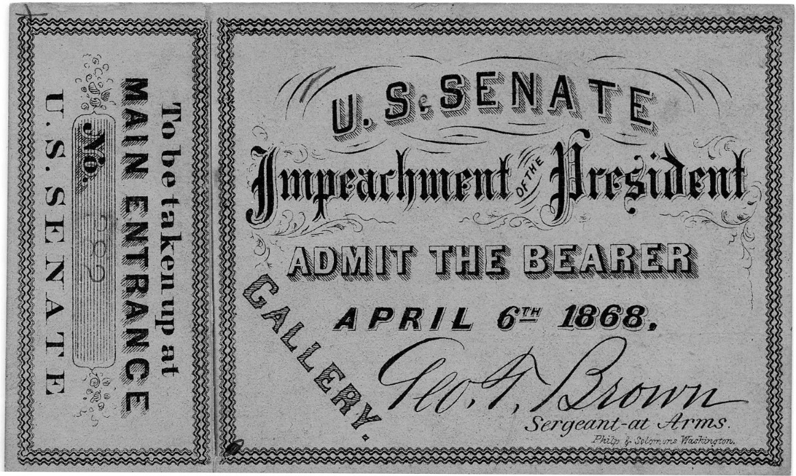
Impeachment of Johnson!
-House of Representatives votes to Impeach Johnson on 11 counts
-Senate fails to convict Johnson by a single vote

Slide 14
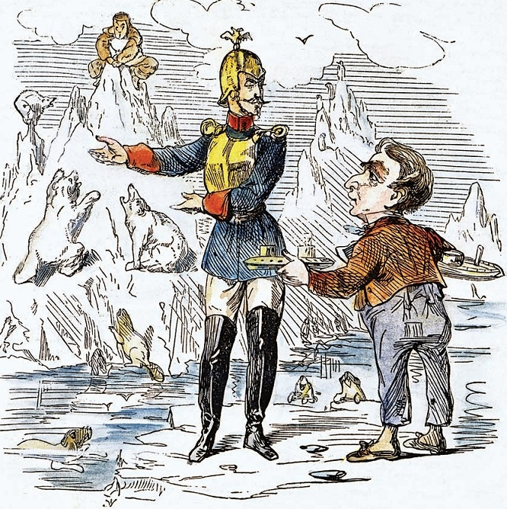
Alaska Purchase
US, through Secretary of State William Seward, buys Alaska from Russia for $7.2 million. (About $12.25 per square mile)

Slide 15
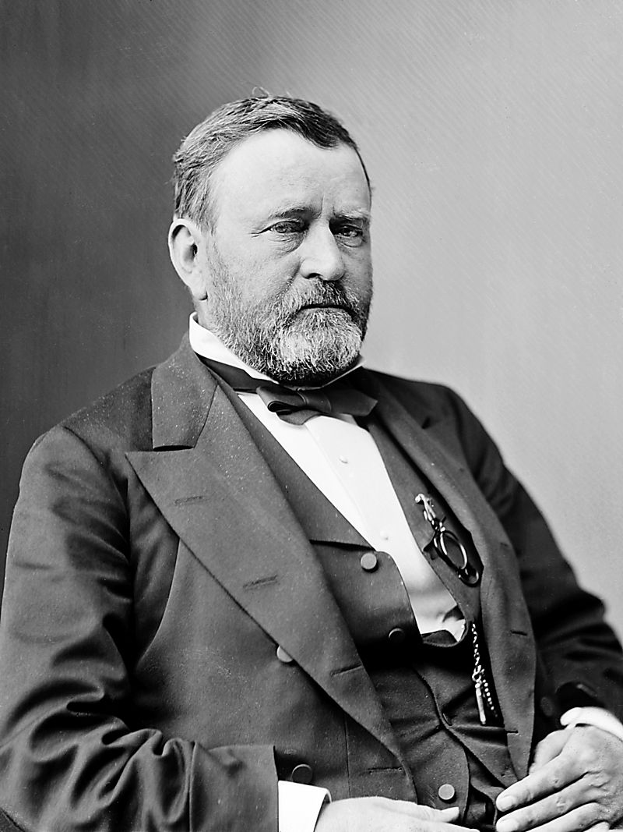
Ulysses S. Grant

Slide 16
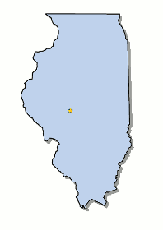
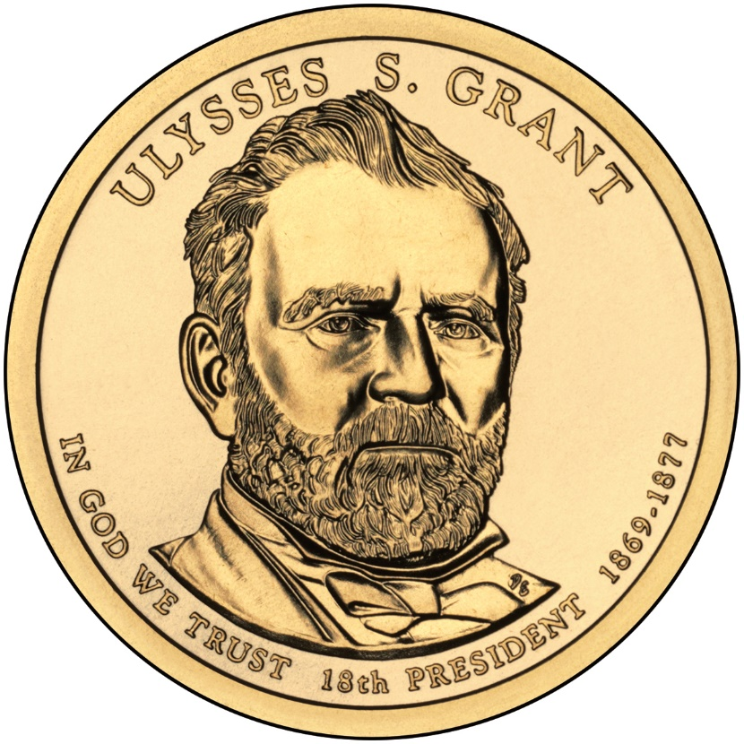
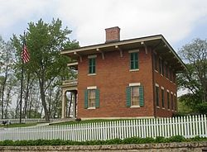
Elected in: 1868, 1872
President from: 1869-1877
Political Party: Republican
Home State: Illinois
(born Ohio)

Slide 17
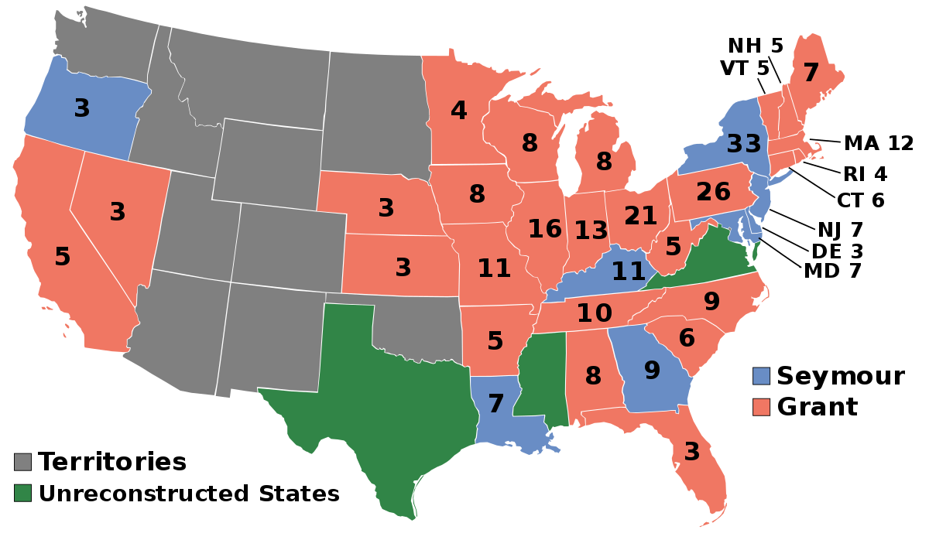
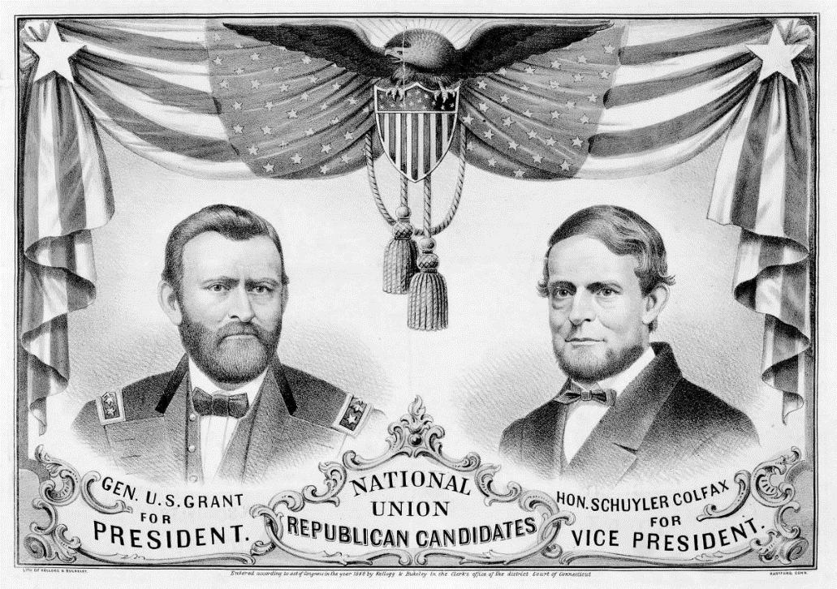
Election of 1868
Republican: 214
President: Ulysses S. Grant
Vice President: Schuyler Colfax
Democratic: 80
President: Horatio Seymour
Vice President: Francis Blair

Slide 18
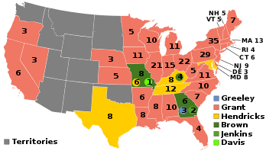
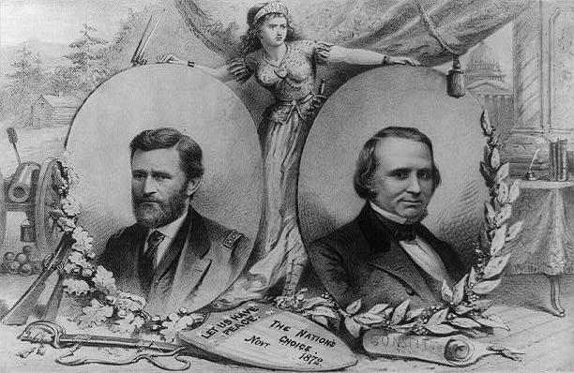
Election of 1872
Republican: 286
President: Ulysses S. Grant
Vice President: Henry Wilson
Liberal Republican/Democratic: 66*
President: Horace Greeley
Vice President: Benjamin Brown

Slide 19
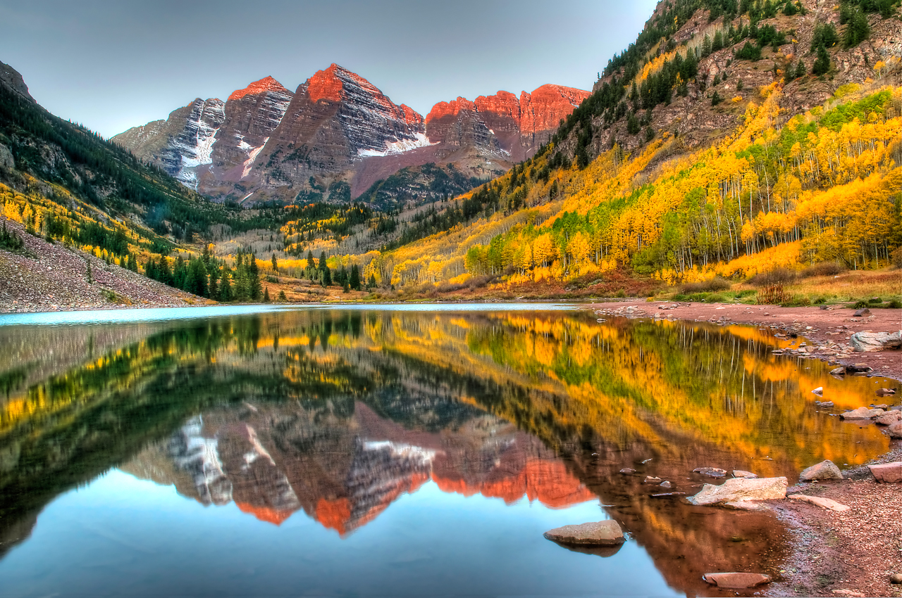
New States
38. Colorado

Slide 20
15th Amendment - 1870
-Former slaves (males only) guaranteed to right to vote.
The right of citizens of the United States to vote shall not be denied or abridged by the United States or by any State on account of race, color, or previous condition of servitude.

Slide 21
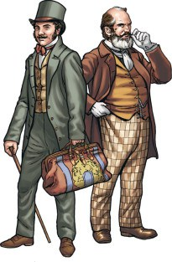
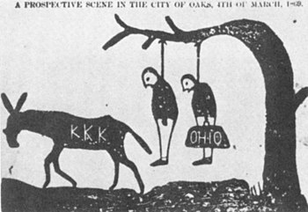
Reconstruction during the Grant Administration:
Carpetbagger: Northerner who moved to the South after the Civil war, usually for economic or political reasons
Scalawag: White Southerners who joined the Republican Party and/or helped with Reconstruction efforts.

Slide 22
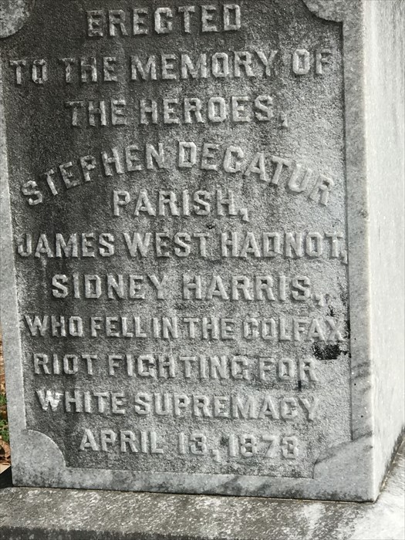
Reconstruction during the Grant Administration:
Colfax massacre:
Go to:
https://www.smithsonianmag.com/smart-news/1873-colfax-massacre-crippled-reconstruction-180958746/
(Link is also on my webpage and Google classroom)
What was the cause of the trouble in Grant Parish?
What was the White League?
How many African Americans were killed, and under what unusual circumstances?
Write a new, accurate plaque for Louisiana to put at the site. Limit to 50 words.

Slide 23
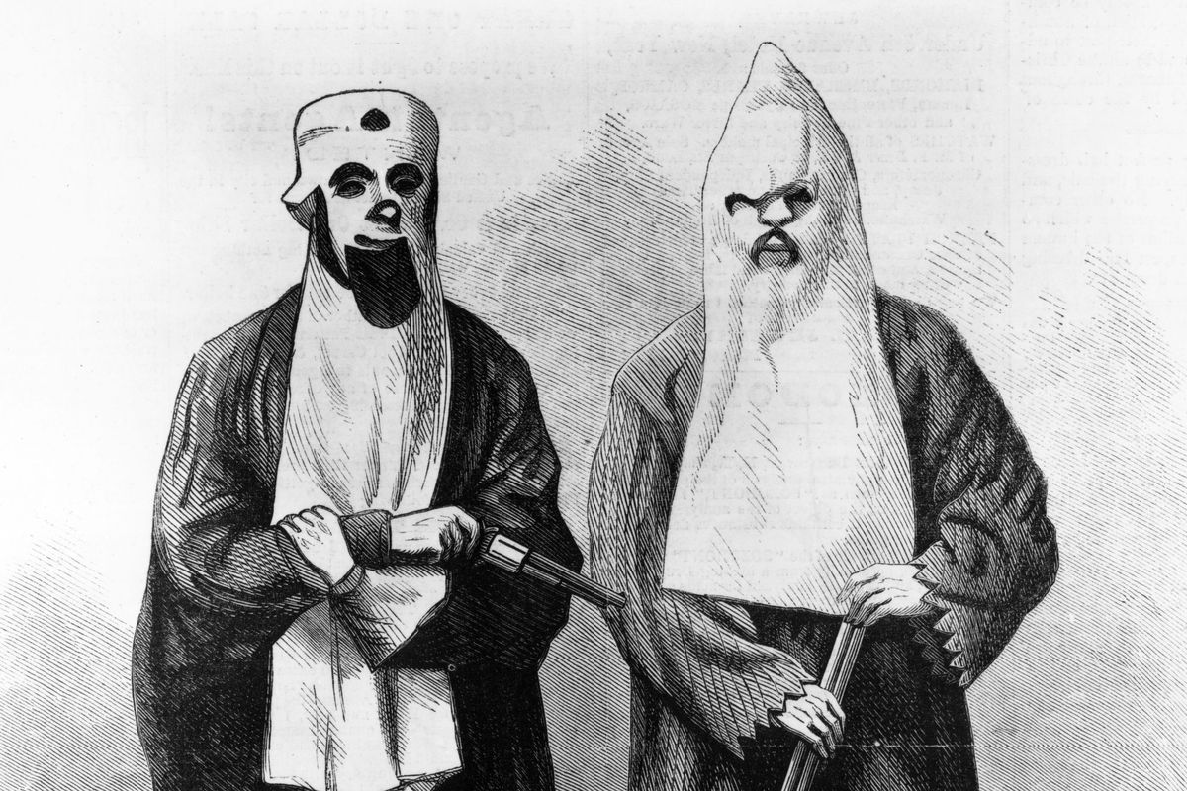
Reconstruction during the Grant Administration:
Enforcement Acts: AKA The Ku Klux Klan Acts
- Designed to stop violence across the South perpetrated by racist terror groups such as the Ku Klux Klan, the Order of the White Camellia, etc.
- Banned use of violence and terror to keep people from voting
Federal forces can be called in to supervise elections in Southern cities
Forbids wearing disguises, planning conspiracies, and intimidation of officials
- President has right to use armed forces to stop any rebellion against the acts

Slide 24
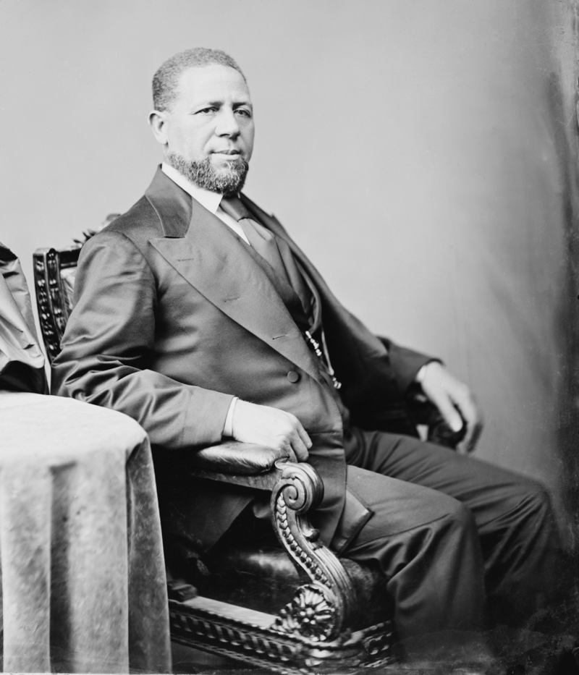
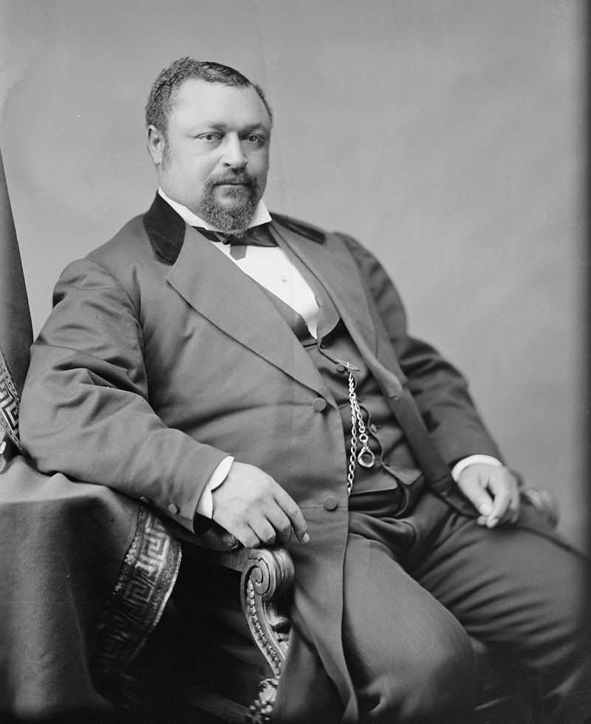
Hiram Revels (R-Mississippi)
First African-American in the Senate
Blanche K. Bruce (R-Mississippi)
First elected African-American in the Senate

Slide 25
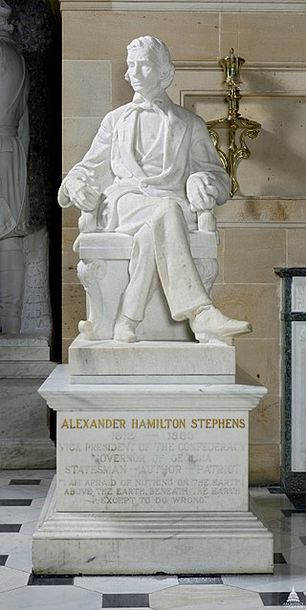
Amnesty Act - 1872
Removed most penalties on former Confederates
Could now run for elected office
Most charges against them were dropped
All but 500 top Confederate leaders were pardoned

Slide 26
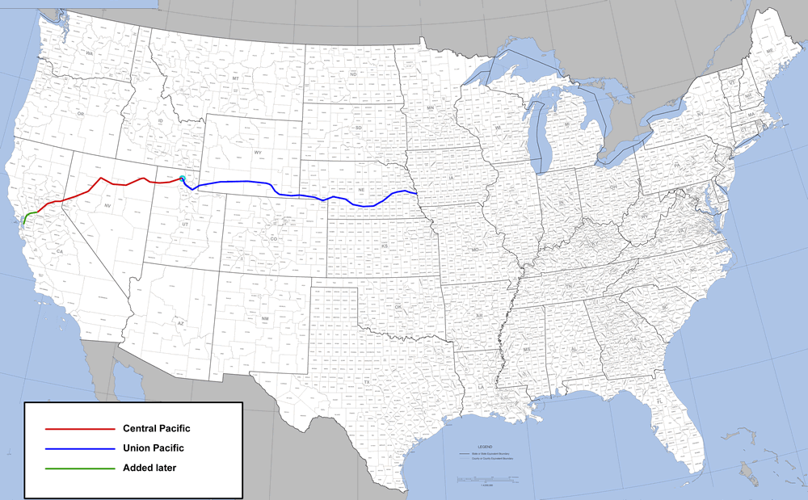
Transcontinental Railroad
- Railroad built from Omaha, Nebraska to Oakland, California
- Connected east and west coasts of the US for the first time
Central Pacific RR built from CA eastwards, using mostly Chinese labor
Union Pacific RR built from Omaha westwards, using mostly Irish labor and former soldiers
Two sides met May 10, 1869 in Promontory Summit, Utah and set the Golden Spike

Slide 27
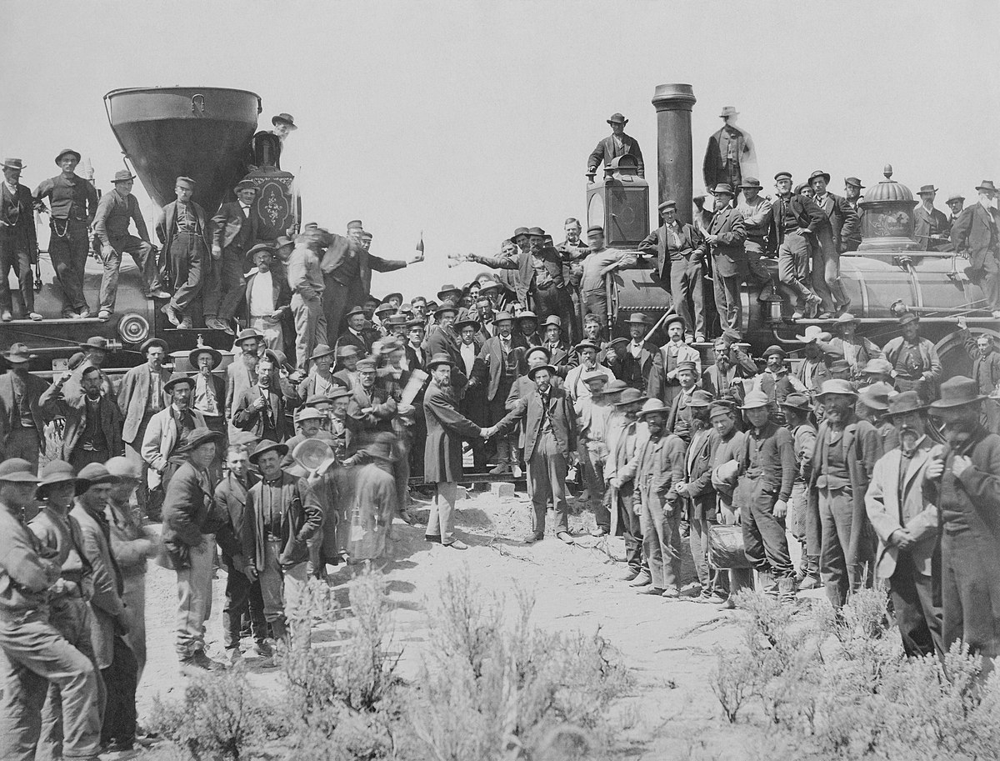

Slide 28
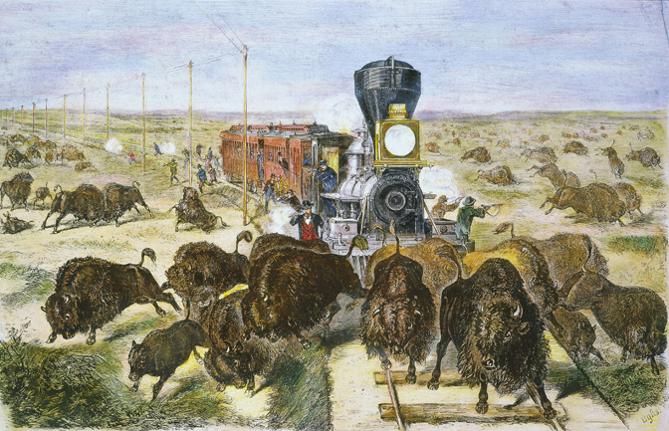
Effects of the Transcontinental Railroad
Travel time from New York to San Francisco reduced from six months to one week. Costy reduced from $1000 to $150
Within 15 years US adopts Standardized time zones
End of the era of covered wagons on long trails
Growth of industry and resources
People could now travel for pleasure, not just
migration and business
Increased forced relocation of Indians to
reservations
Decimation of the bison (buffalo)

Slide 29
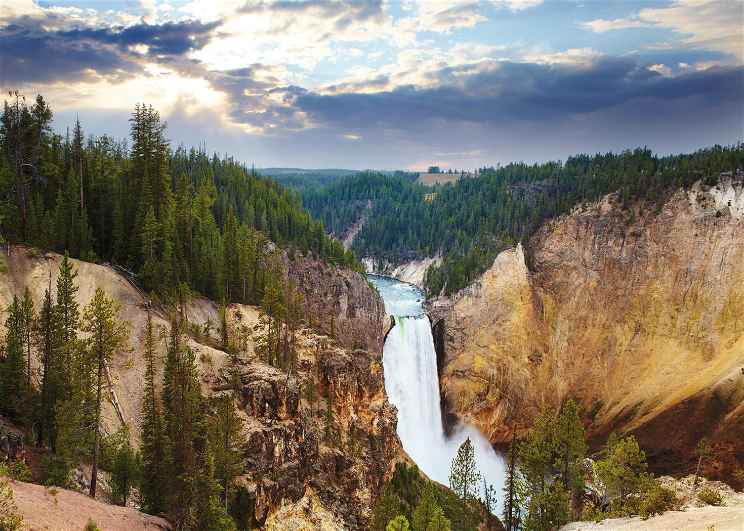
1872 – Yellowstone National Park established - first national park in the world

Slide 30
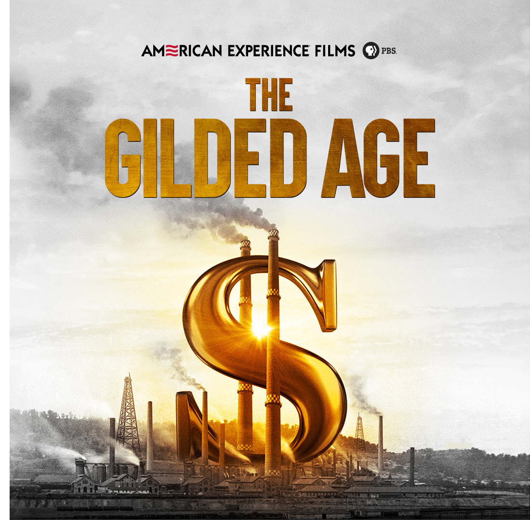

Slide 31
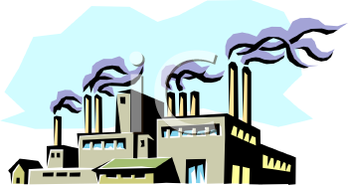
The Gilded Age: The period from the 1870s to 1890s - Rapid economic growth, industrialization, and invention - Rapid wage growth - Rapid population growth and immigration - Era of severe poverty and the concentration of wealth among the elite - Era of strikes and corruption (economic and political)

Slide 32
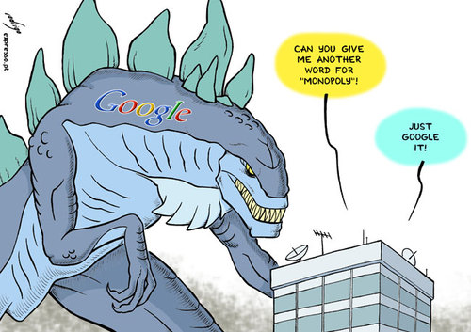
Monopoly: exclusive control of a commodity or service in a particular market, or a control that makes possible the manipulation of prices.

Slide 33
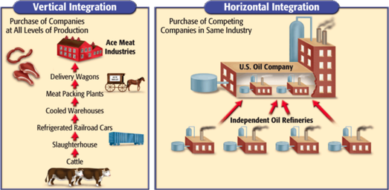
Vertical integration: the combination in one company of two or more stages of production normally operated by separate companies.
Horizontal Integration: the combination into one company of multiple separate companies engaged in the same stage of production. Can become a monopoly.

Slide 34
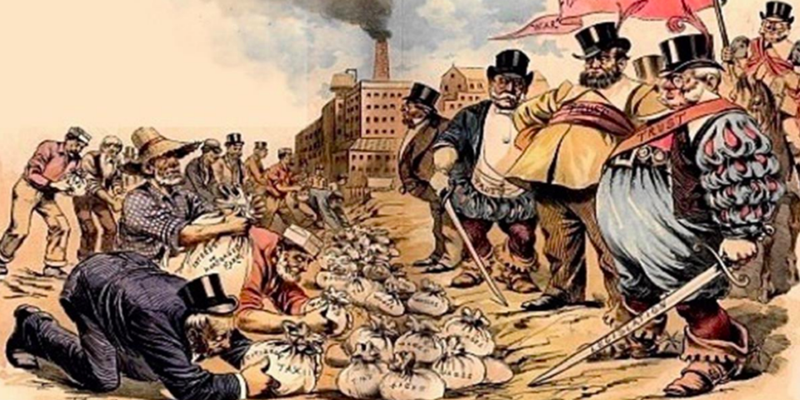
Robber Baron: A ruthlessly powerful industrialist considered to have become wealthy by exploiting natural resources, corrupting legislators, or other unethical means.
AKA: “A Captain of Industry”

Slide 35
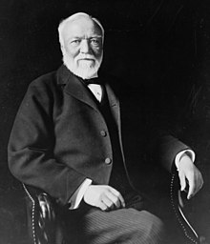
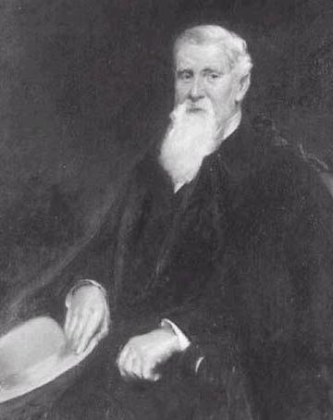
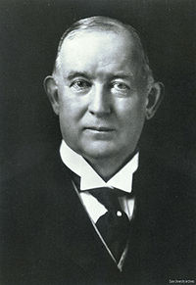
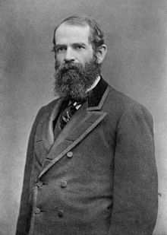
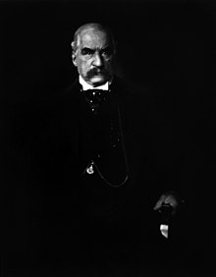
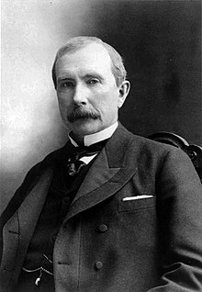
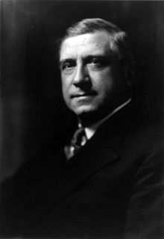
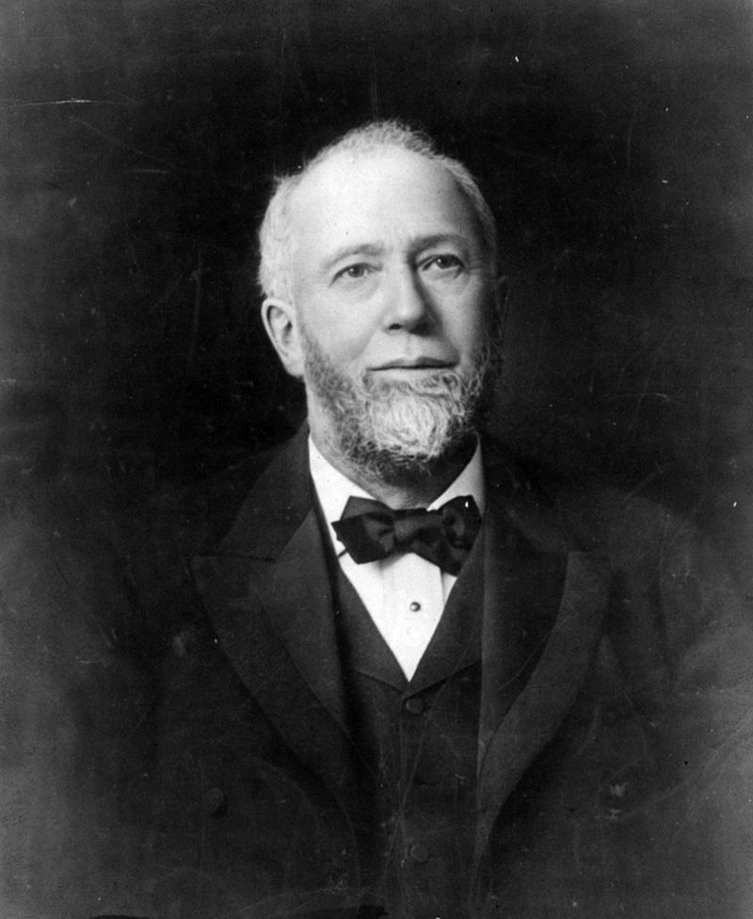
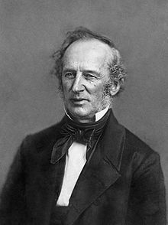
Andrew Carnegie - Steel
Jay Cooke - Finance
James Duke - Tobacco
Jay Gould - Railroads
J.P. Morgan - Banking
John D. Rockefeller- Oil
Charles Schwab - Steel
Gustavus Swift – Meat packing
Cornelius Vanderbilt - Shipping

Slide 36
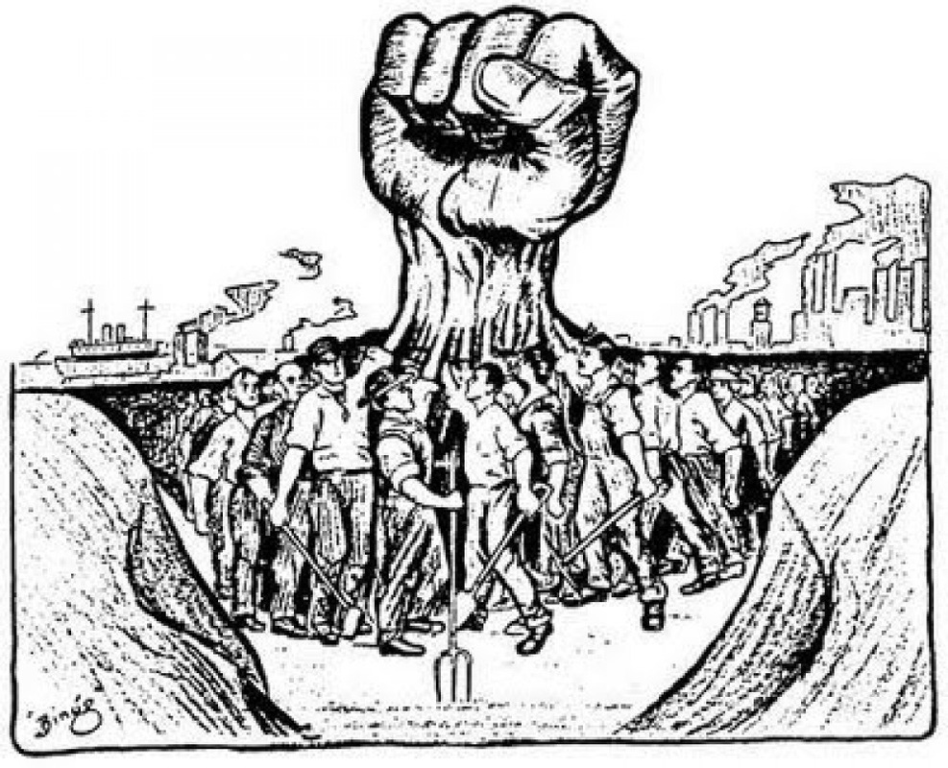
Labor Union: An organization of wage earners or salaried employees for mutual aid and protection
and for dealing collectively with employers

Slide 37
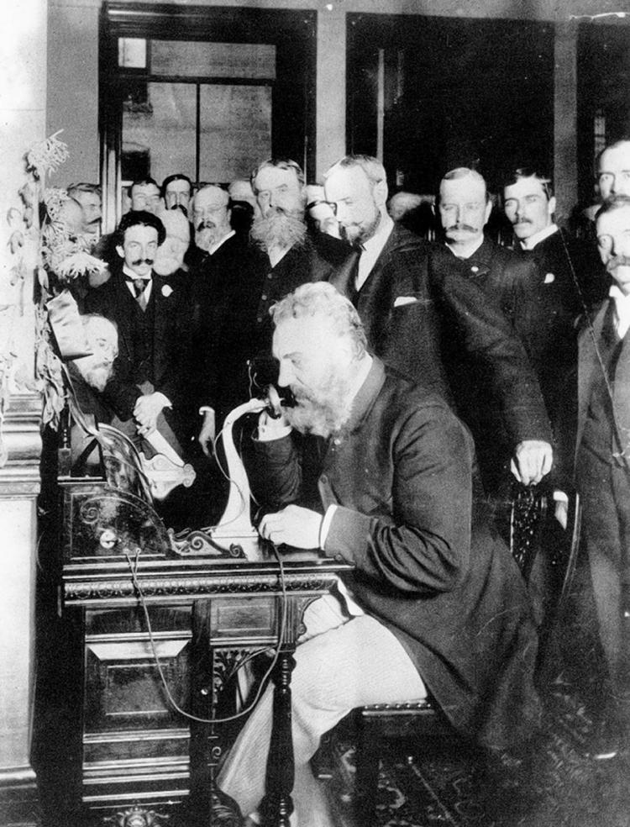
1876 – Invention of the telephone -Alexander Graham Bell, a Canadian from Scotland living in Boston - “Mr. Watson, come here – I want to see you.”

Slide 38
SCANDALS OF THE GRANT ADMINISTRATION
With friends like these, who needs enemies?

Slide 39
SCANDAL!
1869 - Black Friday (The Gold Ring)
Investors Jay Gould and James Fisk attempt to buy up the nation’s gold supply, raise the price, then sell.
Grant’s own brother in law involved when he tried to keep Grant from stopping Fisk and Gould
Grant has US Government sell $4 million in gold to keep the price low, ruining thousands of investors
Triggered a financial panic for which some blamed Grant

Slide 40
SCANDAL!
1872 - Credit Mobilier Scandal:
Credit Mobilier of United States: Dummy corporation set up by the Union Pacific Railroad, and given construction contracts by the railroad.
Company bribed many in government with company stock to pass laws favoring the construction company with subsidies
VP Colfax and several other Republicans are implicated
Grant had nothing to do with it

Slide 41
SCANDAL!
1873 - The Panic:
Bank of Jay Cooke & Company failed due to overinvestment in railroads
Set off a chain of bank failures, and the stock market crashed
Economic depression lasted for 5 years, wages fell
By 25%, thousands of businesses go bankrupt, double-digit unemployment lasted a decade

Slide 42
SCANDAL!
1875-1876
Sanborn & Belknap Scandals
1874: “Special agent” Tax collector John Sanborn, with approval from the Sec’y of the Treasury, kept half of the overdue tax money he collected ($200,000)
1876: Secretary of War William Belknap resigns after being charged with accepting bribes from businessmen wanting to get trading rights on Indian Reservations

Slide 43
SCANDAL!
1875: The Whiskey Ring
Federal officials in charge of collecting taxes on liquor received kickbacks from distilleries for not collecting the taxes in full
Distilleries kept the extra money themselves
Grant’s personal secretary Oliver Babcock among those charged, but Grant naively protected him
Although not part of the “ring”, Grant was seen as part of corruption problem.

Slide 44
Battle of the Little Big Horn – June 25, 1876
An 1868 treaty gave the Sioux (Lakota) tribe the rights to the Black Hills in South Dakota.
In 1874 gold is discovered, and white miners and settlers flock to the Black Hills.
Sioux went to war, US Army sent in to stop them.
June 25, 1876 General George A. Custer and 265 men attack 2500 Sioux, Cheyenne, and Arapaho led by Sitting Bull.
Custer and all his men are killed.

Slide 45
Rutherford B. Hayes

Slide 46
Elected in: 1876
President from: 1877-1881
Political Party: Republican
Home State: Ohio

Slide 47
Election of 1876
Republican: 185*
President: Rutherford B. Hayes
Vice President: William Wheeler
Democratic: 184*
President: Samuel J. Tilden
Vice President: Thomas Hendricks

Slide 48
Election of 1876:
.
Tilden won popular vote and was ahead in electoral college 184-165, but 20 votes were contested from our states: Florida, South Carolina, Louisiana, and Oregon.
A commission is formed to decide who got those 20 votes – made up of 8 Republicans and 7 Democrats.
The Commission awarded the votes to Hayes by a vote of 8-7.
Democrats accept result, as long as Federal troops are withdrawn from the South.
This effectively ends Reconstruction.

Slide 49
New States
None

Slide 50
Machine Politics: An authoritative boss (or small group) commands the support of a group of supporter, businesses, and campaign workers who receive rewards for their efforts. The machine's power is based on the ability of the workers to ”get out the vote” for their candidates on election day.
Most famous and effective: Tammany Hall – Democratic, New York City, run by William “Boss” Tweed until 1872, and mostly Irish thereafter.
Most prominent in large cities like Boston, New York, Chicago, Kansas City, Etc.

Slide 51
Civil Service Reform
1877: Hayes bans government workers from political activity, then fires Chester Arthur for that reason.
Hayes earns the wrath of NY Senator Roscoe Conkling
Republicans break into Stalwarts (in favor of machine politics) and the Half-Breeds (supporters of Hayes).

Slide 52
Great Railroad Strike - 1877
Baltimore and Ohio railroad cuts wages 10% (3rd wage cut since 1873)
Strike begins in Martinsburg WV and soon spreads to other railroads as far as Chicago and Albany.
Strike is violently suppressed by state militia and soon the US Army
Over 100,000 workers participated, over 1000 jailed, over 100 killed

Slide 53
The Grange
Starts in the South as “the Patrons of Husbandry” and spread through the Midwest. Goals of improving agricultural practices and making life better for the farmer
Began lobbying state legislatures to end railroad monopolies on grain transportation and storage (“Granger Laws”)
Munn v. Illinois: Supreme Court Case. A private enterprise that affects the public interest is subject to government regulation.

Slide 54
Nez Perce War
Nez Perce were a tribe living in NE Oregon. Guaranteed to keep their land by treaty, the treaty was broken in 1873 and the Nez Perce had to move to Idaho.
Warfare erupted between angry tribal warriors and white settlers, causing the tribe to outrun the pursuing US Army
The Nez Perce almost escaped to safety in Canada but were caught.
Nez Perce Leader: Chief Joseph
"I am tired of fighting. Our chiefs are killed.... The old men are all killed.... It is cold and we have no blankets. The little children are freezing to death. My people, some of them, have run away to the hills and have no blankets, no food; no one knows where they are, perhaps freezing to death. I want time to look for my children and see how many of them I can find. Maybe I shall find them among the dead. Hear me, my chiefs, I am tired; my heart is sick and sad. From where the sun now stands, I will fight no more forever."

Slide 55
“Lemonade Lucy” Hayes
Lucy Hayes was a very popular First Lady. Women copied her hairstyle and clothing.
She was the first to be called “First Lady”. She earned the nickname "Lemonade Lucy" because she refused to serve alcohol in the White House.
Hayes was a strong supporter of the temperance movement, and the Hayes’ prohibited the serving of alcohol.

Slide 56
1877 – Invention of the phonograph -Thomas Edison and his team of researchers in Menlo Park, NJ create the first successful commercial sound recording device – first on tinfoil and later wax cylinders.

Slide 57
1879 – Invention of the light bulb -Thomas Edison and his team of researchers in Menlo Park, NJ create the first successful commercial light bulb.

